Slide 1

Pune Region School Dashboard
Comprehensive Analytics, Enrollment Trends, and Management Overview
Presented by
CIBINAYA G
INST26DA030365
https://github.com/Cibinaya/Intern-Nova-Data-Analytics-Project.git

Slide 2






High-Level Enrollment Statistics
17,358
219
269
Total Students enrolled across the monitored institutions in the Pune region.
Total active blocks and administrative regions registered in the dataset.
Total standard 12 enrollments tracked for higher secondary analysis.

Slide 3
Power BI Dashboard Reference
Interactive Filtering: Built with multi-faceted block names and management descriptions.
Category Breakdown: Visualized distributions across primary, upper primary, and secondary school classifications.
Regional Coverage: Detailed blocks including Haveli, Khed, Malshiras, and Indapur.

Slide 4
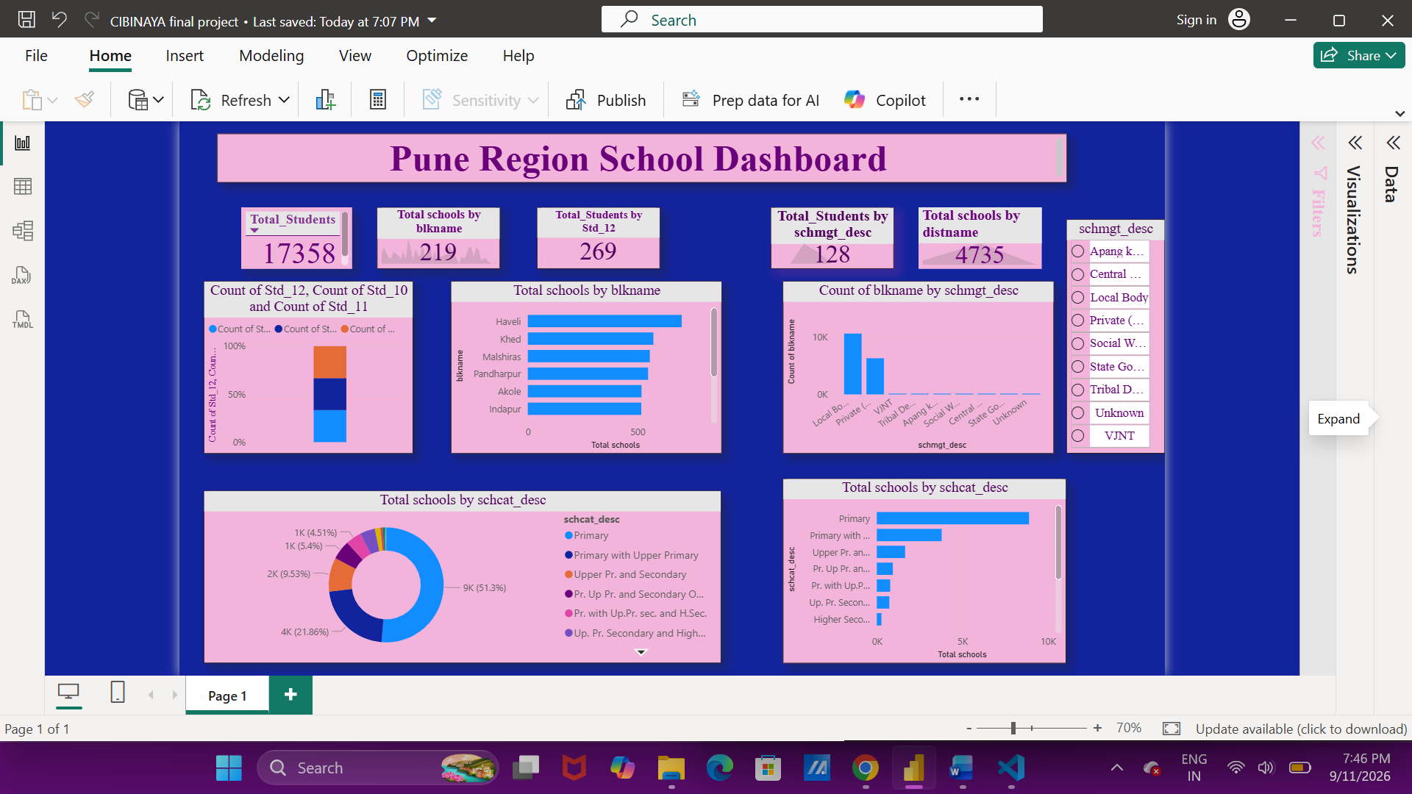
Power BI Dashboard

Slide 5
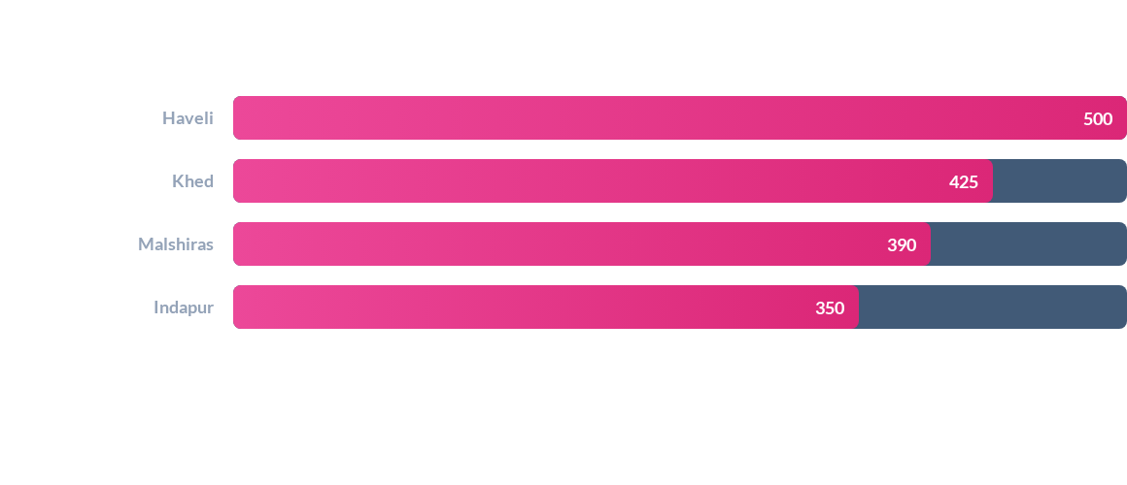
Total Schools by Block Name
Haveli and Khed represent the highest density of educational institutions across the monitored blocks.

Slide 6
RESULTS

Slide 7
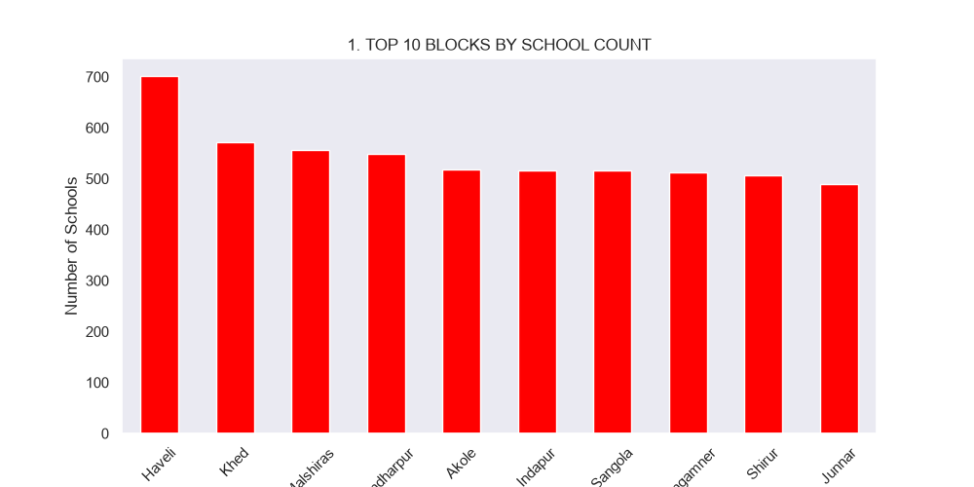
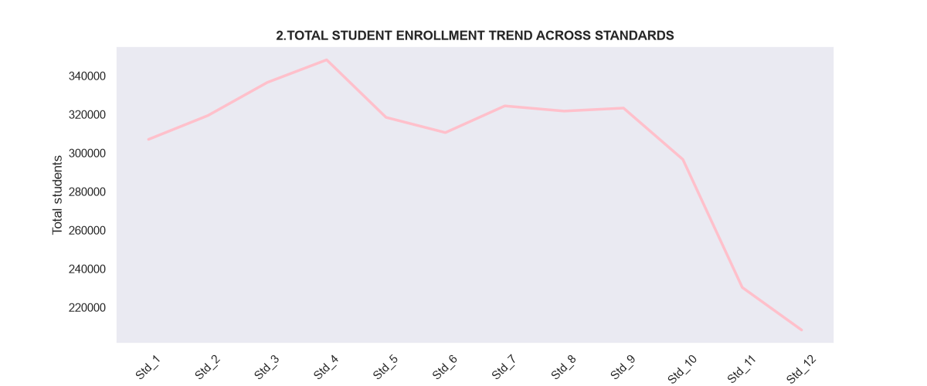

Slide 8
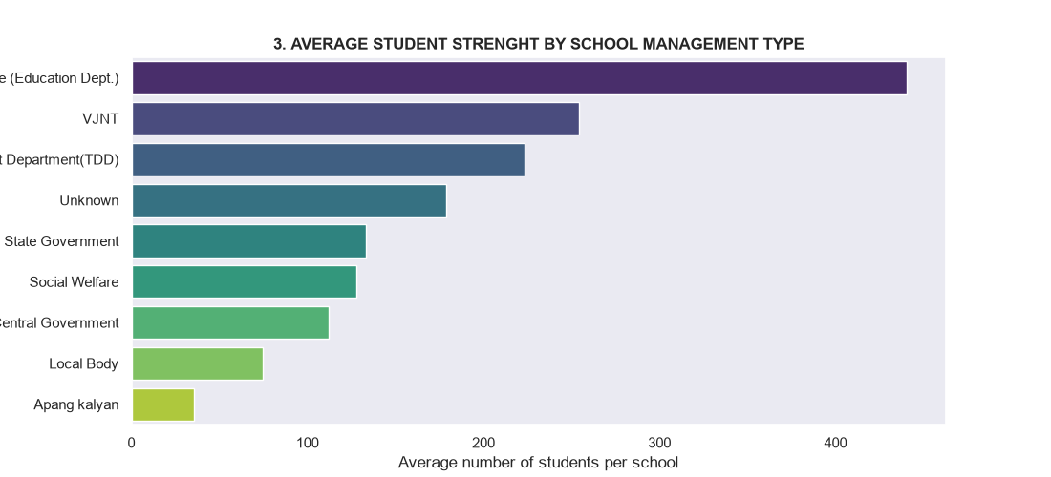
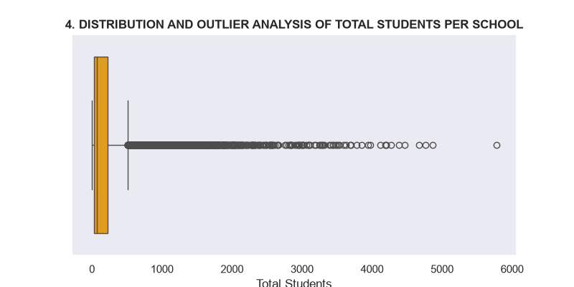

Slide 9
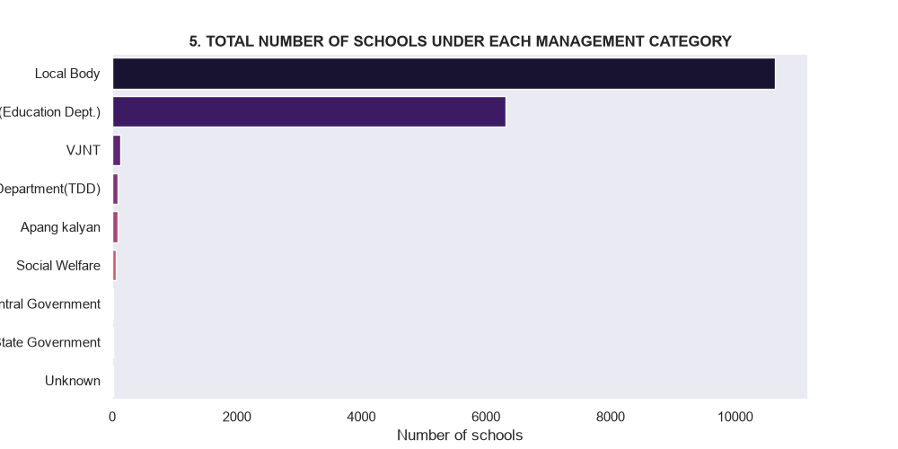

Slide 10


Key Insights & Recommendations
Resource Allocation
Targeted Interventions
Direct infrastructure funding toward high-density blocks like Haveli to support growing student populations effectively.
Enhance standard 12 retention and tracking protocols across rural and semi-urban block subdivisions.

Slide 11

This Photo by Unknown Author is licensed under CC BY-SA

